Slide 1
BALL THROWER
Marc Doctor
Gerard Marcos
Guillem Sánchez

Slide 2
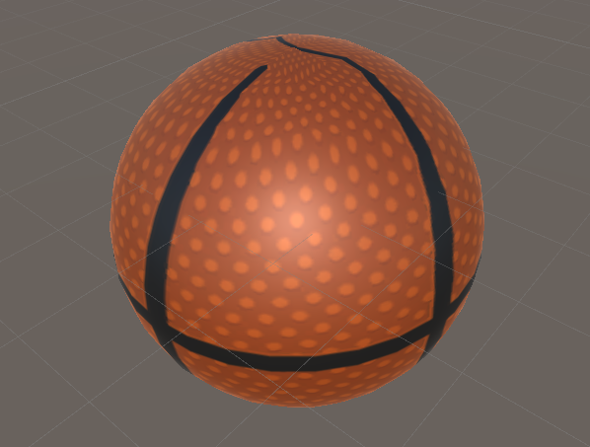
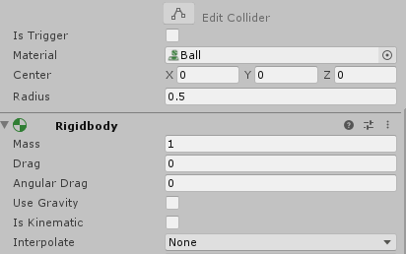
THE BALL & PHYSICS
In front of camera
Moves horizontally
Physics mat = bounce

Slide 3
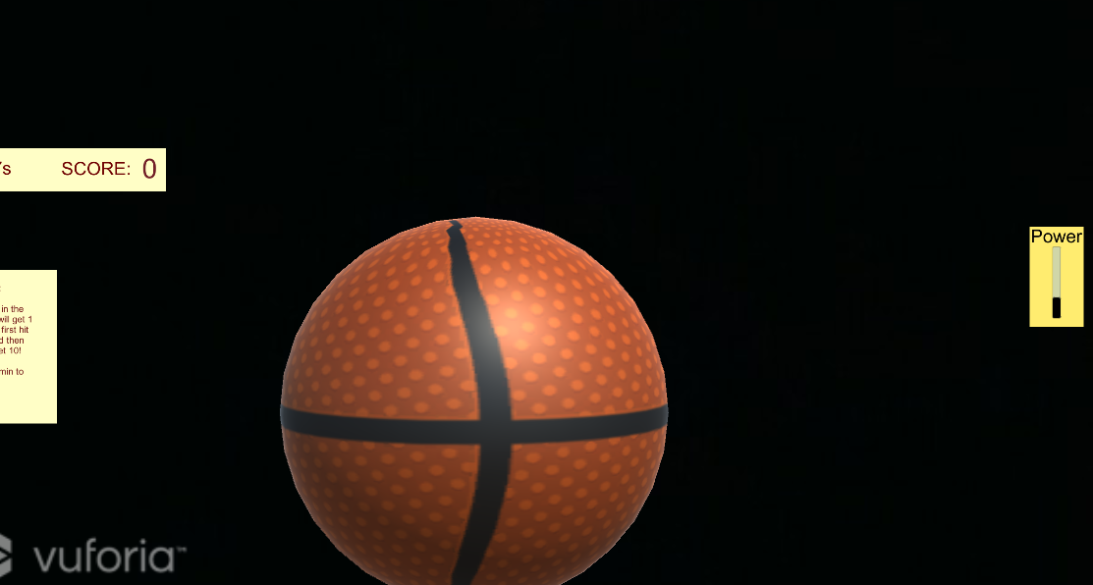



SHOOTING
Press to stop ball
Drag power to shoot
Hit rim or basket
Offscreen = new ball

Slide 4
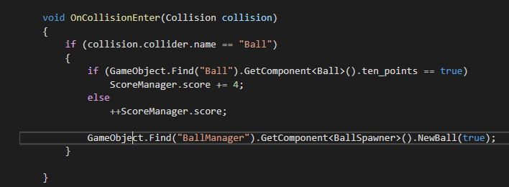
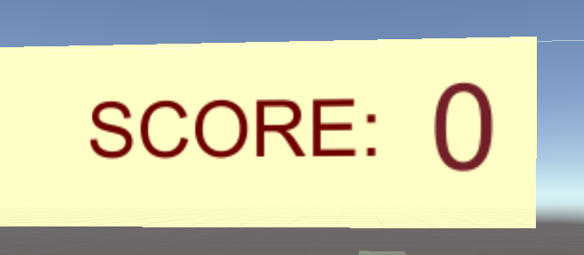
POINT SYSTEM
Normal basket = 1P
Bounce basket = 4P

Slide 5
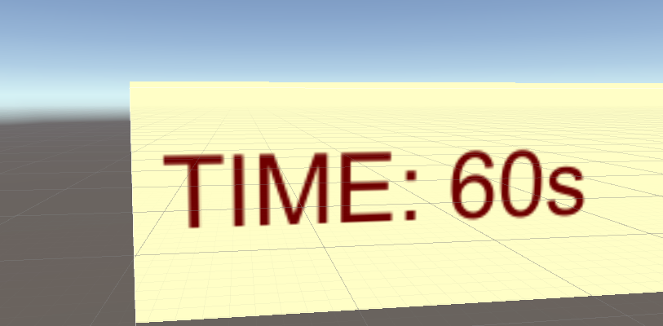
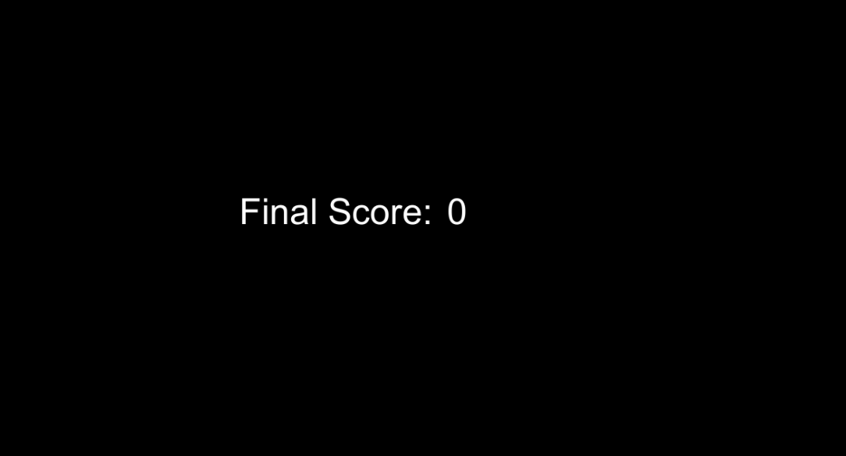
TIMER, UI
1 min total time!
Power ScrollBar
Basket pop-ups

Slide 6
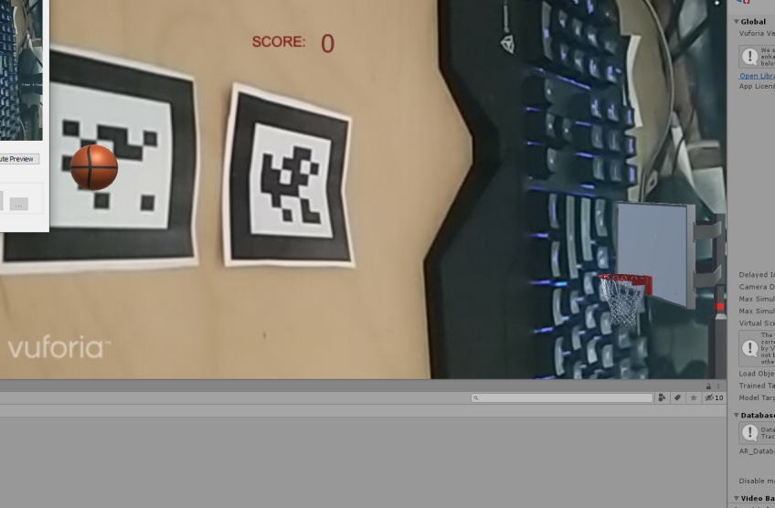
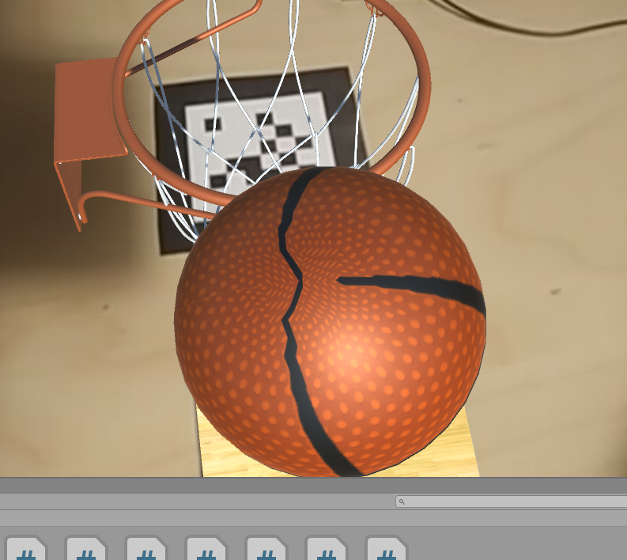
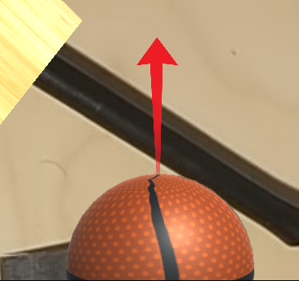
SOLVED PROBLEM: 2D → 3D
2D was a mess
Doesn’t work with AR
Discarded 3D arrow

Slide 7
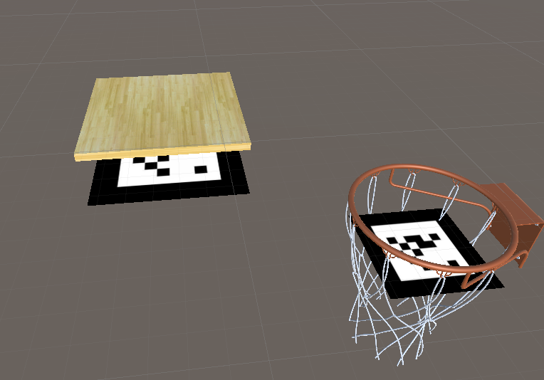
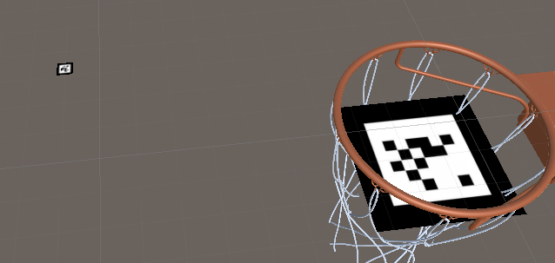
SOLVED PROBLEM: DEPTH
World vs ARCamera
UI, Ball...
Markers size

Slide 8

SOLVED PROBLEM: FLIP
Markers flipped axis
Couldn’t be detected
Only in mobile camera

Slide 9

GAMEPLAY

Slide 10
THANKS
Marc Doctor
Gerard Marcos
Guillem Sánchez

